Slide 1
How to Make Games at Home for Cheap
Or, How to Stop Worrying and Just Go Indie

Slide 2
Let’s Begin by Crushing Some Dreams…
Most indie success stories are flukes. For every millionaire doing what we do, there are tens of thousands of us who’ve yet to break 3, or even 2 figures in sales.
An idea is worthless if it isn’t in the hands of someone capable of delivering on it. Those people usually have plenty of their own ideas.
The bigger an idea is, the harder it is to get it off the ground. Unless you’ve been doing it a while you probably don’t have a good perspective of scale so there’s a good chance whatever you want to do is too big for you to tackle right now.
You will never see an MMO to release.

Slide 3
The Good News
If you still want to make games after that last slide, congratulations, you’re well on your way to being a developer!
Getting started can be fun, easy, and best of all free!
Just about every game development tool available has a free or cheap alternative.
Interest in game development has soared in recent years. This has led to an incredible volume of resources for aspiring developers. It has never been easier to get started.
The tools and resources we’ll be showing you here are all you need to make your first game.

Slide 4
What Do You Need to Make a Game?
An engine
Art
Sound
Place to put it

Slide 5
What is a Game Engine?
A game engine is a collection of standard resources required by most games. These include systems for rendering graphics, handling collisions and physics, etc...
Most developers primarily interface with the editor portion of the engine.
While there are engines that are build to make one style of game, most of the popular engines can be used to make any sort of game you can think of.
Engine isn’t super important, don’t get caught in that trap. Just pick one and run with it

Slide 6

Game Engines
Engine | Price | Need to Code? | Language | Royalties | License | Platforms | Popular Games
Unity | 0 - 125 mo. | Yes, but has visual scripting options | C# | No | Proprietary | PC, Consoles, VR | Hearthstone, Outer Wilds, Cuphead
Unreal | 0 | Yes, but has visual scripting options | C++ | Yes | Proprietary | PC, Consoles, VR | Borderlands 3, Days Gone, Unreal Tournament
Game Maker | 39-199 | No, but you can | GML | No | Proprietary | PC, Consoles | Hyper Light Drifter, Nuclear Throne, Spelunky
Godot | 0 | Yes | Python | No | Open Source | PC, Consoles, VR | Stereobreak, Deep Sixed, Shipwreck
RPG Maker | 4-20(sale price) | No, but you can | RGSS | No | Proprietary | PC | To the Moon, Skyborn, Corpse Party
Twine | Free | No | HTML/CSS | No | Open Source | PC | Depression Quest, Open Sorcery, The Temple of No

Slide 7
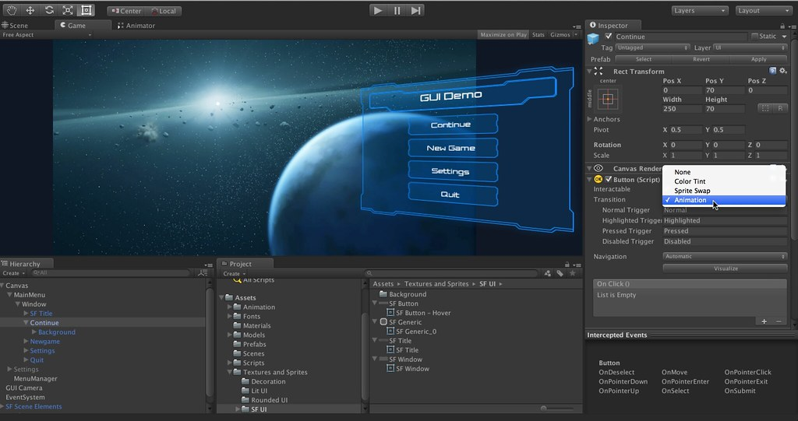
Unity
Pros
Industry standard software.
Powerful and flexible
Supported by massive community
One of the most thoroughly documented engines
Ability to extend the editor functionality with script
Cons
Difficult for beginners
UI tools can be unintuitive
Can occasionally be pretty buggy

Slide 8
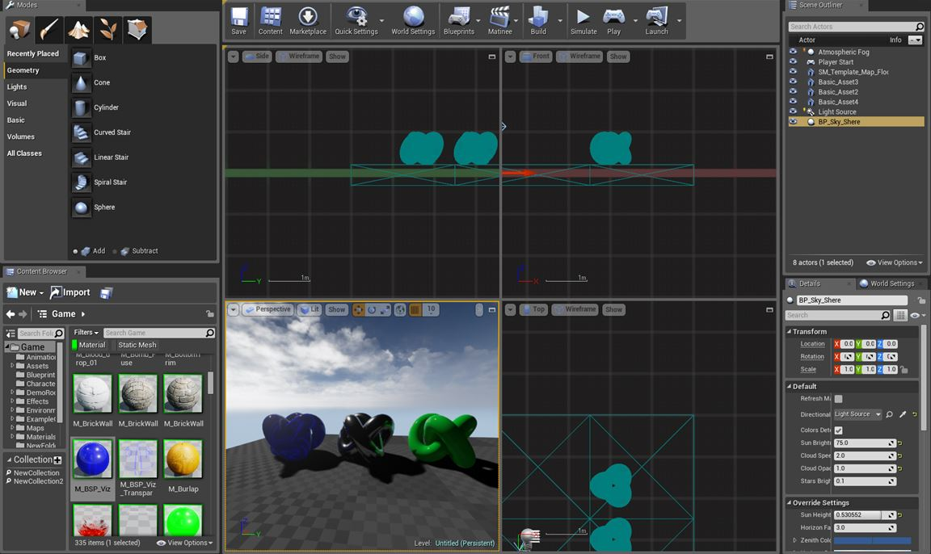
Unreal
Pros-
High Quality Rendering Pipeline – Pretty Graphics!
In-Engine Material Editor
Access to source code
Visual scripting
Cons
High learning curve
Lack of Documentation
Large project size
Expected to use Blueprints – can get messy and hard to maintain
2D support is lacking, and it doesn’t seem to be a focus at Epic

Slide 9
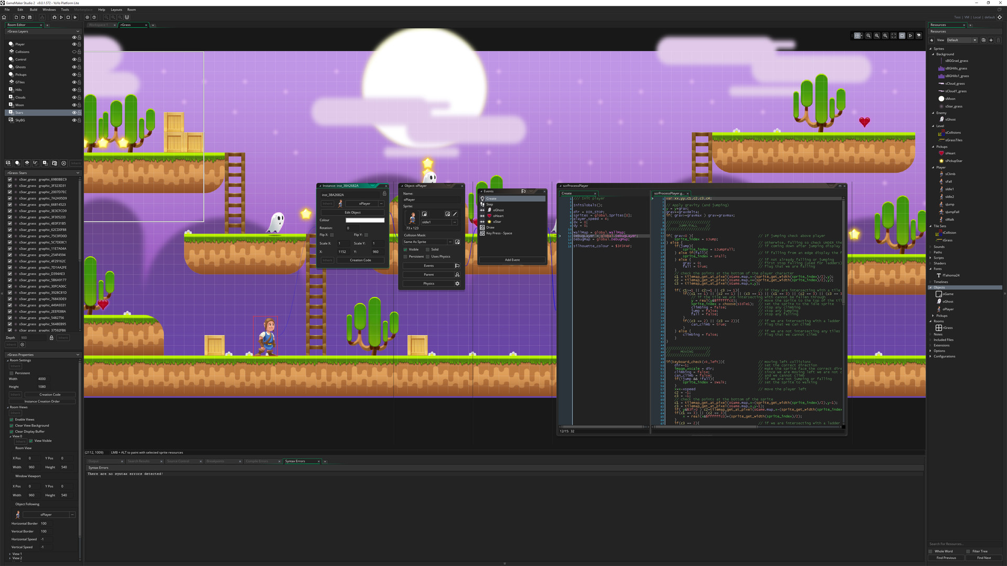
Game Maker
Pros
Easy for beginners
Robust visual scripting tools
If you buy it once, you have it forever. No additional licenses or royalties are necessary.
Cons
Unsuitable for 3D development
The more you learn, the more control you’ll want. The ease of use that makes it great for beginners can make it frustrating for advanced users.

Slide 10
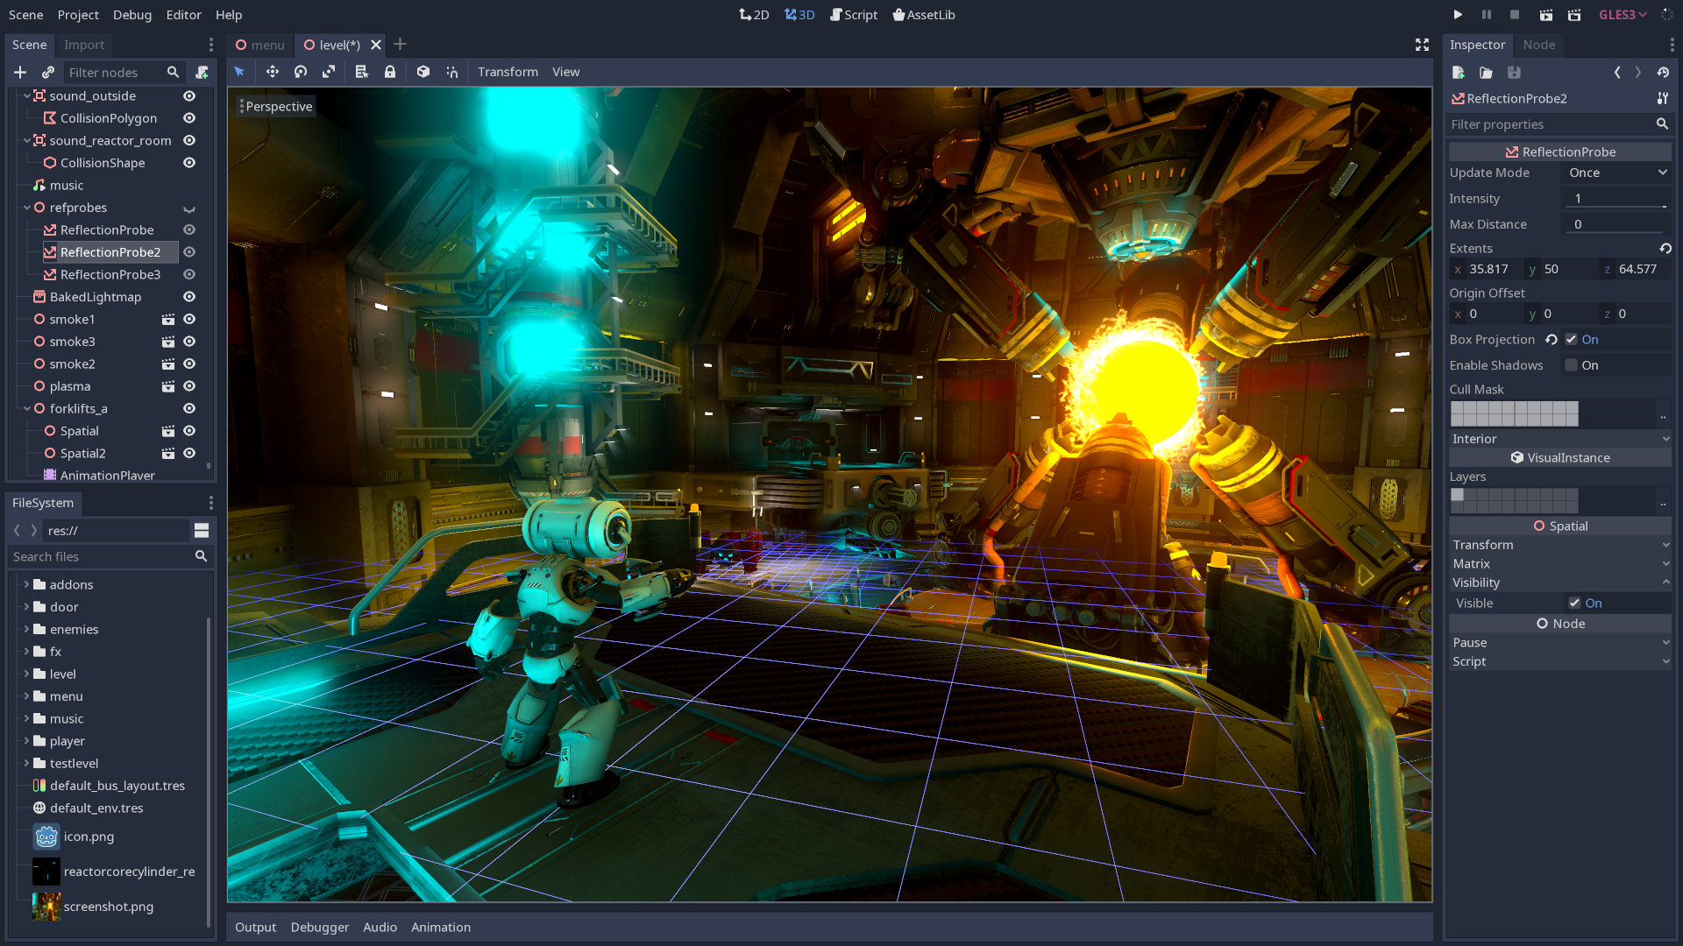
Godot
Pros
Completely free and open source
Just about as robust and powerful as its major competitors
Prop
Cons

Slide 11
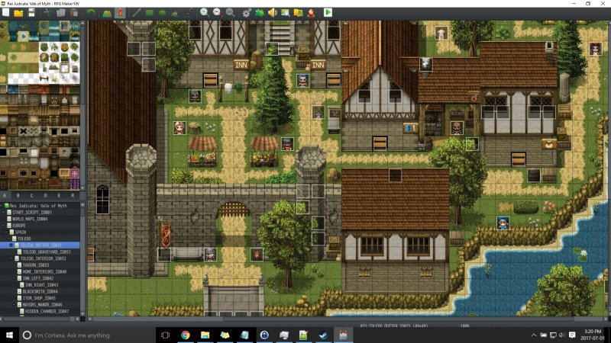
RPG Maker
Pros
Simple to use
Simplifies and streamlines a generally difficult to make game type
Premade Assets and Characters
Active community
Cons
Only really meant to make RPG’s
Coding for it has next to no documentation
Has a distinctively cheap look if premade assets are used
Hard to extend functionality

Slide 12
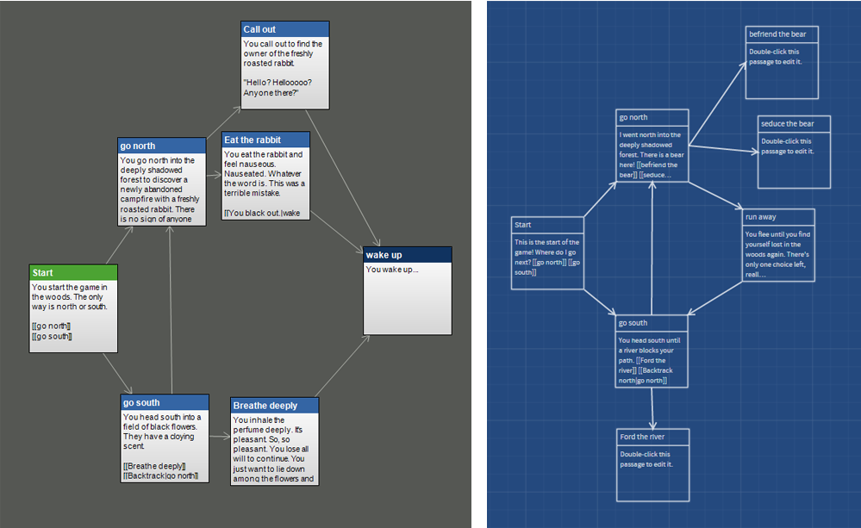
Twine
Pros
Cons

Slide 13
The Indie Economy
Golden rule of independent game design – If you spend money to make a game, you’ve lost money.
There is a lot of money in the scene, just not for any of us.
Passion does not always lead to high sales, You have to find the balance between passion and marketability.
Marketing is key, and none of us can afford marketing

Slide 14
Useful Resources
Itch.io – Lots of devs release asset packs and tools for free or on the cheap.
Reddit (r/Gamedev, r/[insert engine]) – lots of useful posts and help on engine specific problems
Stack Overflow – More on the coding side, but there is nothing these people can’t answer.
The Official Forums for your Engine – Much like the others, there is specific help and mods that actually work for the company that supports the engine.
OpenGameArt.com – Literally thousands of free assets to use in prototypes and jams

Slide 15
Parting Advice
The only thing you need to do to be a game developer is to develop games.
Done is better than perfect
Start Small

